Slide 1
Glove Detection in Manufacturing:
Ablation Study of YOLOv8m-seg
Azimjon Akhtamov
Department of Computer Science, CBNU

Slide 2
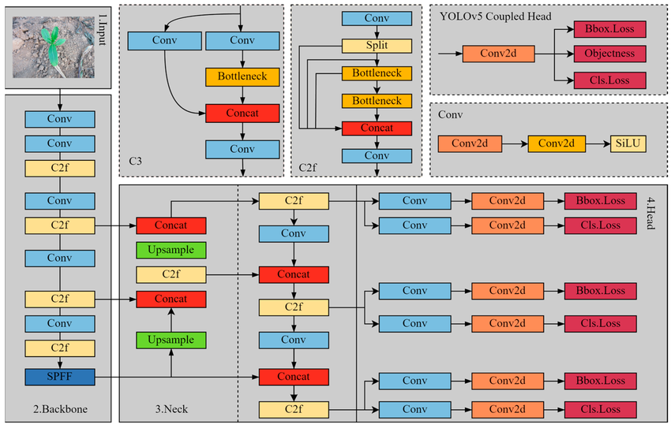
Introduction

Slide 3
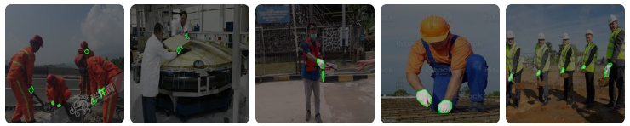
Dataset
Metadata Type | Values
Images | 2,658 (JPG/PNG)
Labels | gloves, nogloves
Class Counts in Lebels | gloves: 3,462 nogloves: 1,657
Labels Format | TXT
Size | 0.81 GB
Background | Construction and industrial safety scenes

Slide 4
Experimental Settings
Parametr | Values
Epochs | 100
Batch Size | 16
Learning Rate | 0.01
Optimizer | AdamW
Weight Decay | 0.0005
Device | CUDA 12.4
GPU | NVIDIA TITAN RTX (24GB)
OS | Windows 11 Pro
Training Strategy
Early Stopping: Patience = 30, stopping early if no improvement is observed for 30 epochs

Slide 5
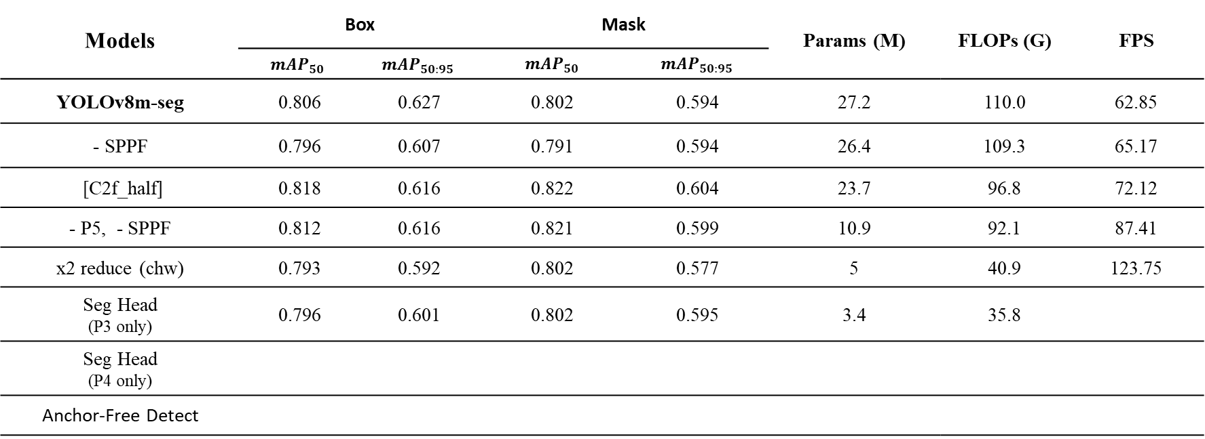
Ablation Study
YOLOv8m-seg
Models | Box |  | Mask |  | Params (M) | FLOPs (G) | FPS
 | $${mAP}_{50}$$ | $${mAP}_{50:95}$$ | $${mAP}_{50}$$ | $${mAP}_{50:95}$$
YOLOv8m-seg | 0.806 | 0.627 | 0.802 | 0.594 | 27.2 | 110.0 | 62.85
- SPPF | 0.796 | 0.607 | 0.791 | 0.594 | 26.4 | 109.3 | 65.17
[C2f_half] | 0.818 | 0.616 | 0.822 | 0.604 | 23.7 | 96.8 | 72.12
- P5, - SPPF | 0.812 | 0.616 | 0.821 | 0.599 | 10.9 | 92.1 | 87.41
x2 reduce (chw) | 0.793 | 0.592 | 0.802 | 0.577 | 5 | 40.9 | 123.75
Seg Head (P3 only) | 0.796 | 0.601 | 0.802 | 0.595 | 3.4 | 35.8
Seg Head (P4 only)
Anchor-Free Detect
FPS measured using PyTorch 2.4.1 on TITAN RTX with batch size = 1 and input resolution 640×640.

Slide 6
Ablation Study #STEP 1
YOLOv8
Inference Speed (FPS): 512×512 resolution [ NVIDIA TITAN RTX ]

Slide 7
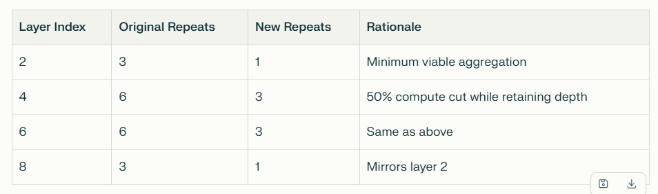
Ablation Study #STEP 2
YOLOv8
Inference Speed (FPS): 512×512 resolution [ NVIDIA TITAN RTX ]

Slide 8
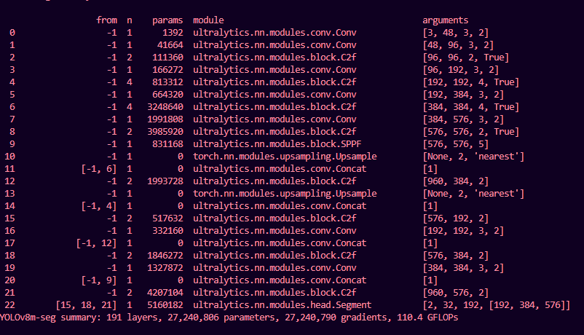
Ablation Study #STEP 3 NO SPPF
YOLOv8
Inference Speed (FPS): 512×512 resolution [ NVIDIA TITAN RTX ]

Slide 9
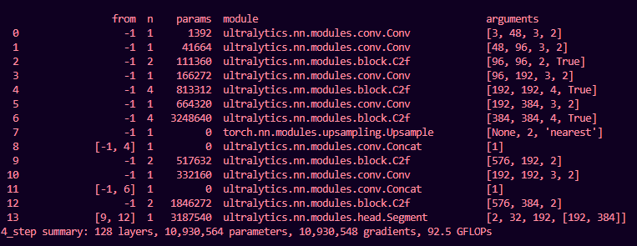
Ablation Study #STEP 4 NO P5 (large)
YOLOv8
Gloves is small object detection, we don’t need P5

Slide 10
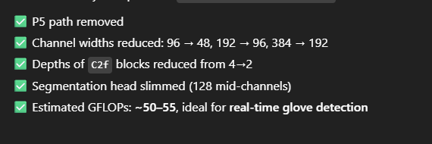
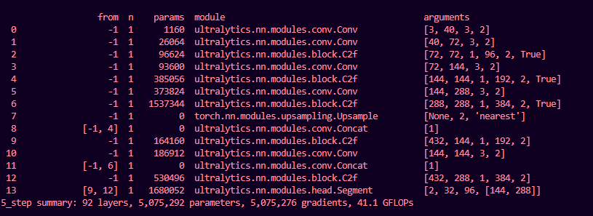
Ablation Study #STEP 5 Reduce channel widths x2
YOLOv8
Inference Speed (FPS): 512×512 resolution [ NVIDIA TITAN RTX ]

Slide 11
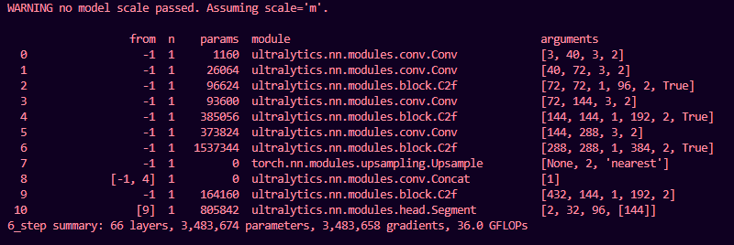
Ablation Study #STEP 6 Segment Head
P3 head only
Inference Speed (FPS): 512×512 resolution [ NVIDIA TITAN RTX ]

Slide 12
#1 New Arch replace
YOLOv8
Include something new to the existing model and make it novel and new. Show improvement results
Inference Speed (FPS): 512×512 resolution [ NVIDIA TITAN RTX ]

Slide 13
#2 New Arch + Keypoint
YOLOv8
Include keypoint and show results
Inference Speed (FPS): 512×512 resolution [ NVIDIA TITAN RTX ]

Slide 14
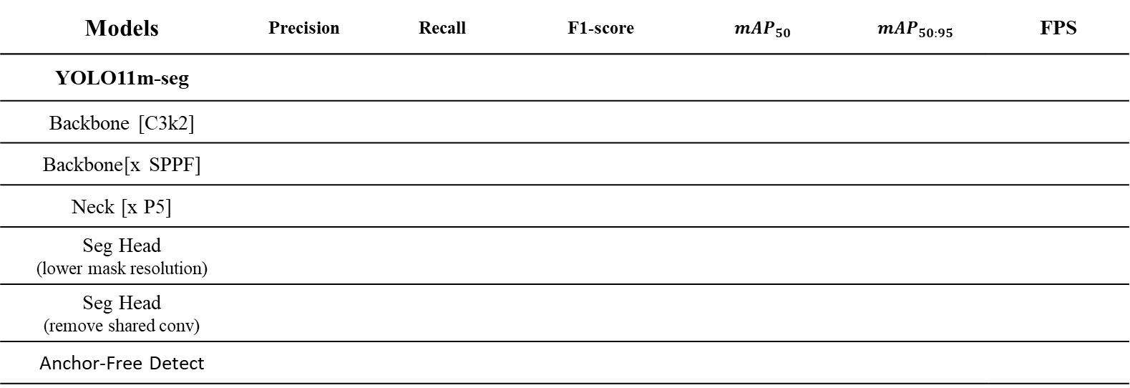
Ablation Study
YOLO11
Models | Precision | Recall | F1-score | $${mAP}_{50}$$ | $${mAP}_{50:95}$$ | FPS
YOLO11m-seg
Backbone [C3k2]
Backbone[x SPPF]
Neck [x P5]
Seg Head (lower mask resolution)
Seg Head (remove shared conv)
Anchor-Free Detect
Inference Speed (FPS): 512×512 resolution [ NVIDIA TITAN RTX ]

Slide 15
Greetings

